Slide 1
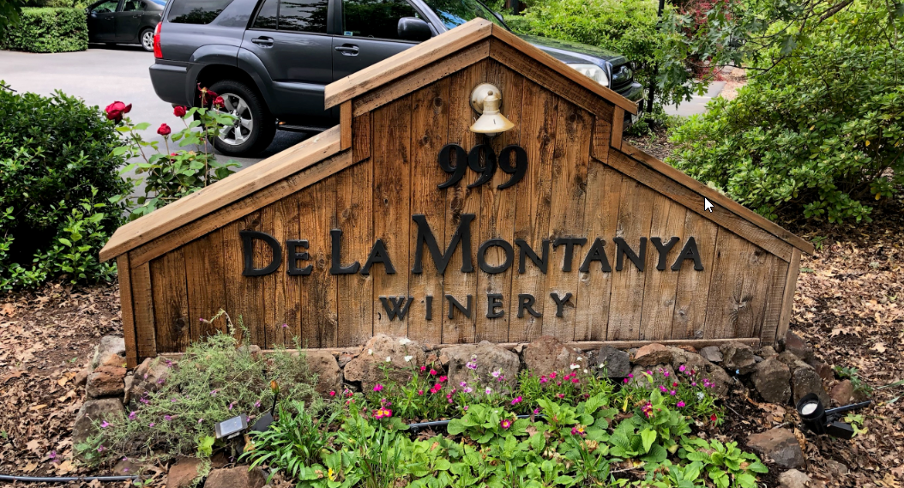
Washoe County Board of Adjustment
August 1, 2019
Administrative Permit Case Number: WADMIN19-0014 (De La Montanya Winery)

Slide 2
Case Description
Administrative permit for a winery use in the Low Density Suburban Regulatory Zone
4,199 sq ft building
  Production area is 1,170 sq ft
  Tasting and barrel rooms will be 2,400 sq ft total.
Located off of Bordeaux Drive
2 acres in size – 1 acre vineyards
No Special Events (Weddings, etc) allowed.

Slide 3
Background
16 parking spaces proposed
    WCC Section 410 requires a minimum of 5 parking spaces
The site is served by municipal water (TMWA) and sewer (Washoe County)
Trip generation is expected to be around 30 ADT
4 full time personnel
This property had CC&R’s established in 1964. The adjacent property owners under the CC&R’s rescinded the CC&R’s in May of 2019.

Slide 4
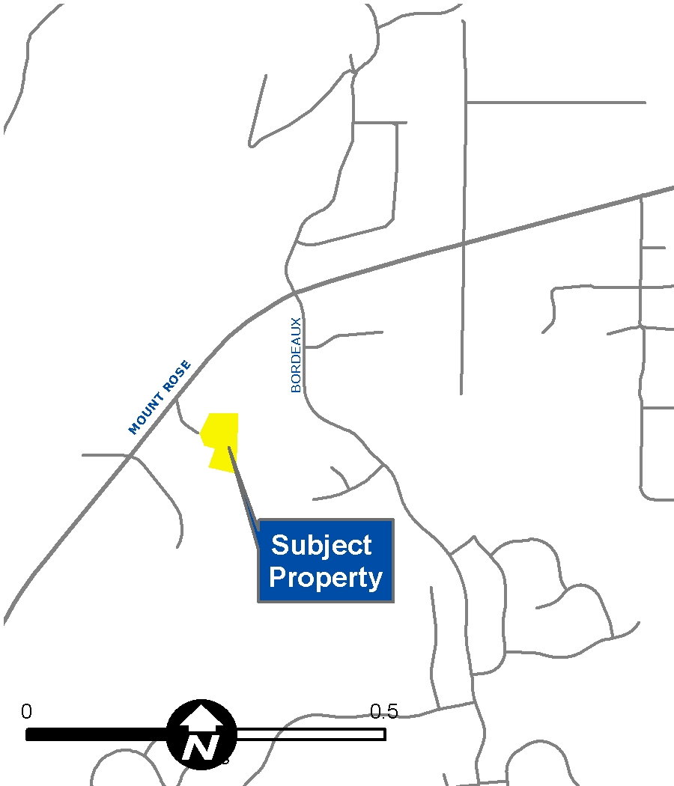
Vicinity Map

Slide 5
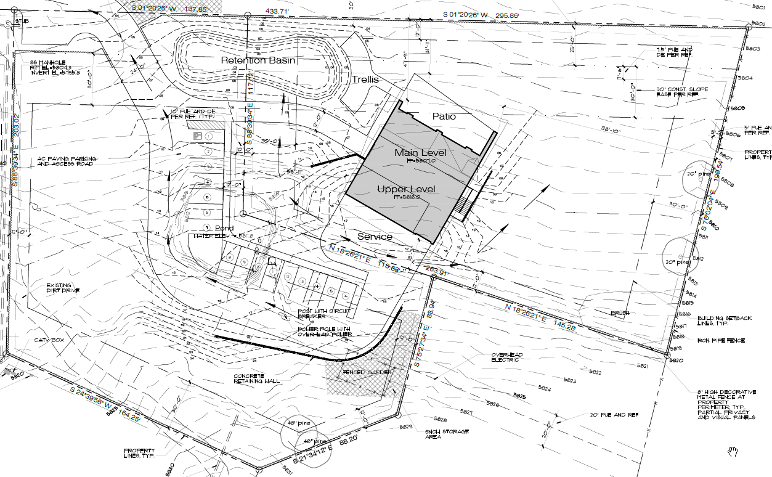
Site Plan

Slide 6
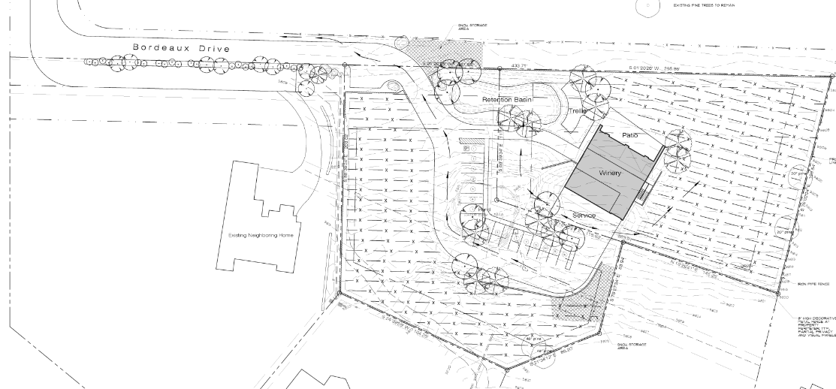
Landscape Plan

Slide 7
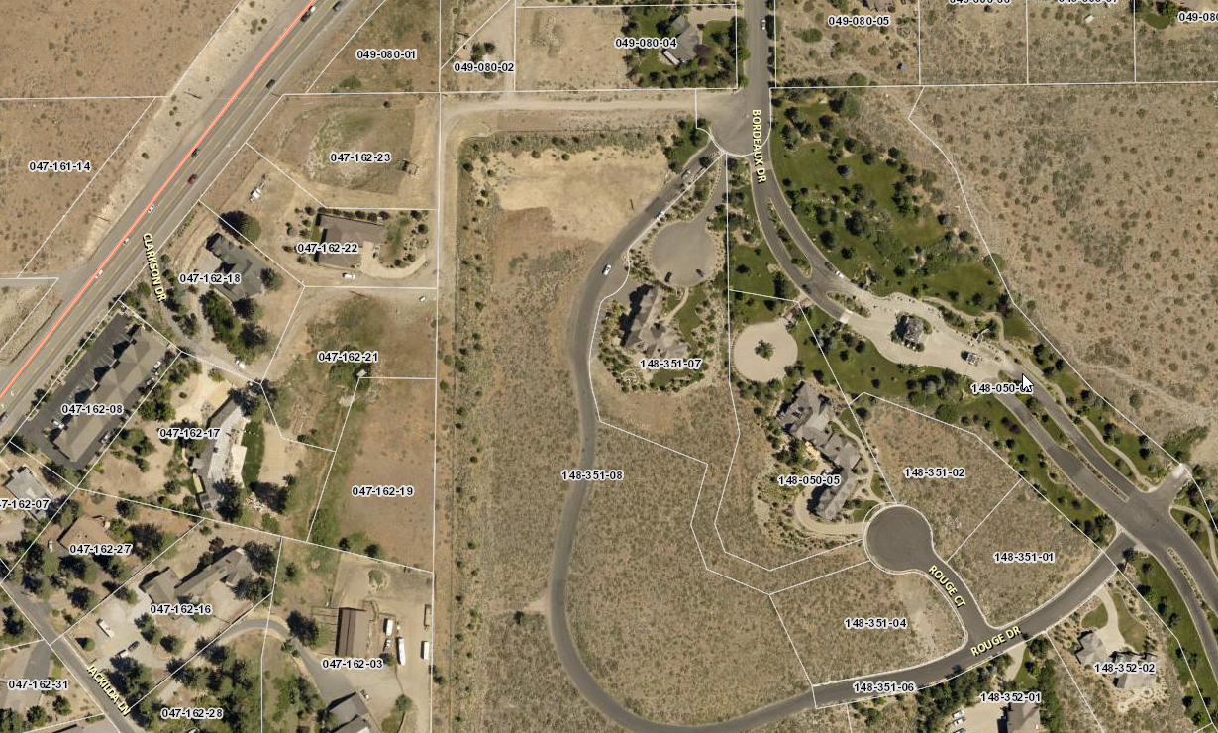
Overhead Photo of Subject Site

Slide 8
Access
There is a roadway irrevocable offer for dedication on Parcel Map No. 3090
Document 1926933 established the irrevocable offer of dedication on September 19, 1995.

Slide 9
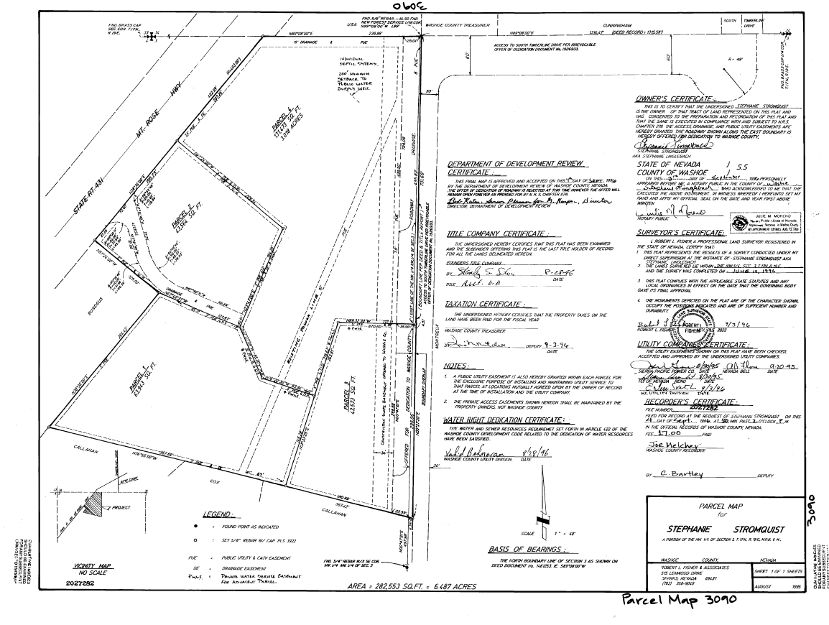
PM 3090

Slide 10
Public Input
Numerous concerns and objections from surrounding residences (Exhibit F)
  Traffic issues on Bordeaux (Congestion, accidents, children on school buses)
  Change of appearance to the entrance of Montreux.
  Negative impact on property values
  Concerns that other businesses may follow

Slide 11
Public Input
Numerous emails in support of the project (Exhibit G)
  Tasting room, not a bar
  Enhance the area
  Increased property values
Public input from neighbors regarding fencing requirements
  Neighbors would prefer to see into the property instead of at a solid fence

Slide 12
Applicant Conditions
The applicant has put forth conditions above and beyond to address public concerns
  Prior to CO the owner will install signage at the exit of the driveway alluding to the presence of school drop off zones and children present.
  Owner will work with WC Engineering to appropriately sign the section of Bordeaux Drive and the entrance of the project with appropriate signage.
  The owner will limit hours of operation to “Appointment Only” on Monday – Thursday, and limit appointments between 2:30 and 4:30 PM.

Slide 13
Conditions of Approval
Staff is proposing a wall or fence required between the commercial and adjacent residential uses be of long-lasting materials (Condition 1g)
  The applicant is requesting this condition be removed.
Applicant is requesting to waive condition 1(h), 1 tree every 20 linear feet, due to the potential negative impacts shade will have on the vineyards.
Parks is requesting to remove their conditions due to an alternate and preferred route for the trail alignment.
Engineering has revised conditions to include a condition related to a private access easement.
The full Conditions of Approval can be found in Exhibit A of the Staff Report.

Slide 14
Conditions of Approval
Staff has worked with the applicant to amend condition 1 (i):
  Existing Language - No outdoor storage of machinery or tools will be permitted. Machinery and tools used for agricultural purposes must be stored indoors.
  New Language – Agricultural machinery and tools shall be screened from adjacent properties when not in use.

Slide 15
Required Findings
1. Consistency. That the proposed use is consistent with the action programs, policies, standards and maps of the Master Plan and the Forest Area Plan;
2. Improvements. That adequate utilities, roadway improvements, sanitation, water supply, drainage, and other necessary facilities have been provided, the proposed improvements are properly related to existing and proposed roadways, and an adequate public facilities determination has been made in accordance with Division Seven;
3. Site Suitability. That the site is physically suitable a winery and crop production use type, and for the intensity of such a development;
4. Issuance Not Detrimental. That issuance of the permit will not be significantly detrimental to the public health, safety or welfare; injurious to the property or improvements of adjacent properties; or detrimental to the character of the surrounding area;
  Galena sport to the North across Mt. Rose Highway
  Great Basin Institute and Caldwell Banker located to the West, both located on LDS regulatory zone property
5. Effect on a Military Installation. Issuance of the permit will not have a detrimental effect on the location, purpose or mission of the military installation.

Slide 16
Recommendation
Those agencies which reviewed the application either made no comments or recommended conditions in support of approval of the project. Therefore, after a thorough analysis and review, Administrative Permit Case Number WADMIN19-0014 is being recommended for approval with conditions.

Slide 17
Motion
I move that, after giving reasoned consideration to the information contained in the staff report and information received during the public hearing, the Board of Adjustment approve Administrative Permit Case Number WADMIN19-0014 for De La Montanya Winery, having made all five findings in accordance with Washoe County Development Code Section 110.808.25

